Slide 1



Slide 2


AGENDA
Introduction
Meet the Team
Why OSS?
Data Model V.1.0
The OSS Effect
Section 1 – Quality Inspection
OPTIMAL SOFTWARE SOLUTIONS
Section 2 – Engineering
Section 3 - Purchasing
Plans Moving Forward

Slide 3
AGENDA
Introduction
Meet the Team
Why OSS?
Data Model V.1.0
The OSS Effect
Section 1 – Quality Inspection
Section 2 – Engineering
Section 3 - Purchasing
Plans Moving Forward
Introduction
Project : OSS-NCR
Project Highlight: Develop a streamlined and efficient product to replace the current NCR procedure.
Developer: Optimal Software Solutions – OSS
Client: Crossfire

Slide 4
Meet the team
AGENDA
Introduction
Introduction
Project : OSS-NCR
Meet the Team
Developer: Optimal Software Solutions – OSS
Why OSS?
Data Model V.1.0
Client: Crossfire
The OSS Effect
Project Highlight: Develop a streamlined and efficient product to replace the current NCR procedure.
Section 1 – Quality Inspection
Section 2 – Engineering
Section 3 - Purchasing
Plans Moving Forward

Slide 5




Introduction
Project : OSS-NCR
Developer: Optimal Software Solutions – OSS
Client: Crossfire
Project Highlight: Develop a streamlined and efficient product to replace the current NCR procedure.
Meet the team
RADIN SHAHRAVAN
MOHAMMAD YASEEN
Sahil Patel
NYLE BUMANGLAG

Slide 6
Meet the team
RADIN SHAHRAVAN
MOHAMMAD YASEEN
Sahil Patel
NYLE BUMANGLAG

Slide 7
Meet the team
RADIN SHAHRAVAN
MOHAMMAD YASEEN
Sahil Patel
NYLE BUMANGLAG

Slide 8
Meet the team
RADIN SHAHRAVAN
MOHAMMAD YASEEN
Sahil Patel
NYLE BUMANGLAG

Slide 9
Meet the team
RADIN SHAHRAVAN
MOHAMMAD YASEEN
Sahil Patel
NYLE BUMANGLAG

Slide 10
MOHAMMAD YASEEN
NYLE BUMANGLAG
Meet the team
RADIN SHAHRAVAN
Sahil Patel
WHY
O
S
S
?
Optimized workflow and methods, ensuring delivery of services in quick time frames.
Skilled and experienced developers crafting your product with intricacy and detail.
Specialized in various programing and developing environments, for anyone and everyone.

Slide 11
O
Optimized workflow and methods, ensuring delivery of services in quick time frames.
S
Skilled and experienced developers crafting your product with intricacy and detail.
S
Specialized in various programing and developing environments, for anyone and everyone.

Slide 12
O
Optimized workflow and methods, ensuring delivery of services in quick time frames.
S
Skilled and experienced developers crafting your product with intricacy and detail.
DATA MODEL v.1.0
S
Specialized in various programing and developing environments, for anyone and everyone.

Slide 13
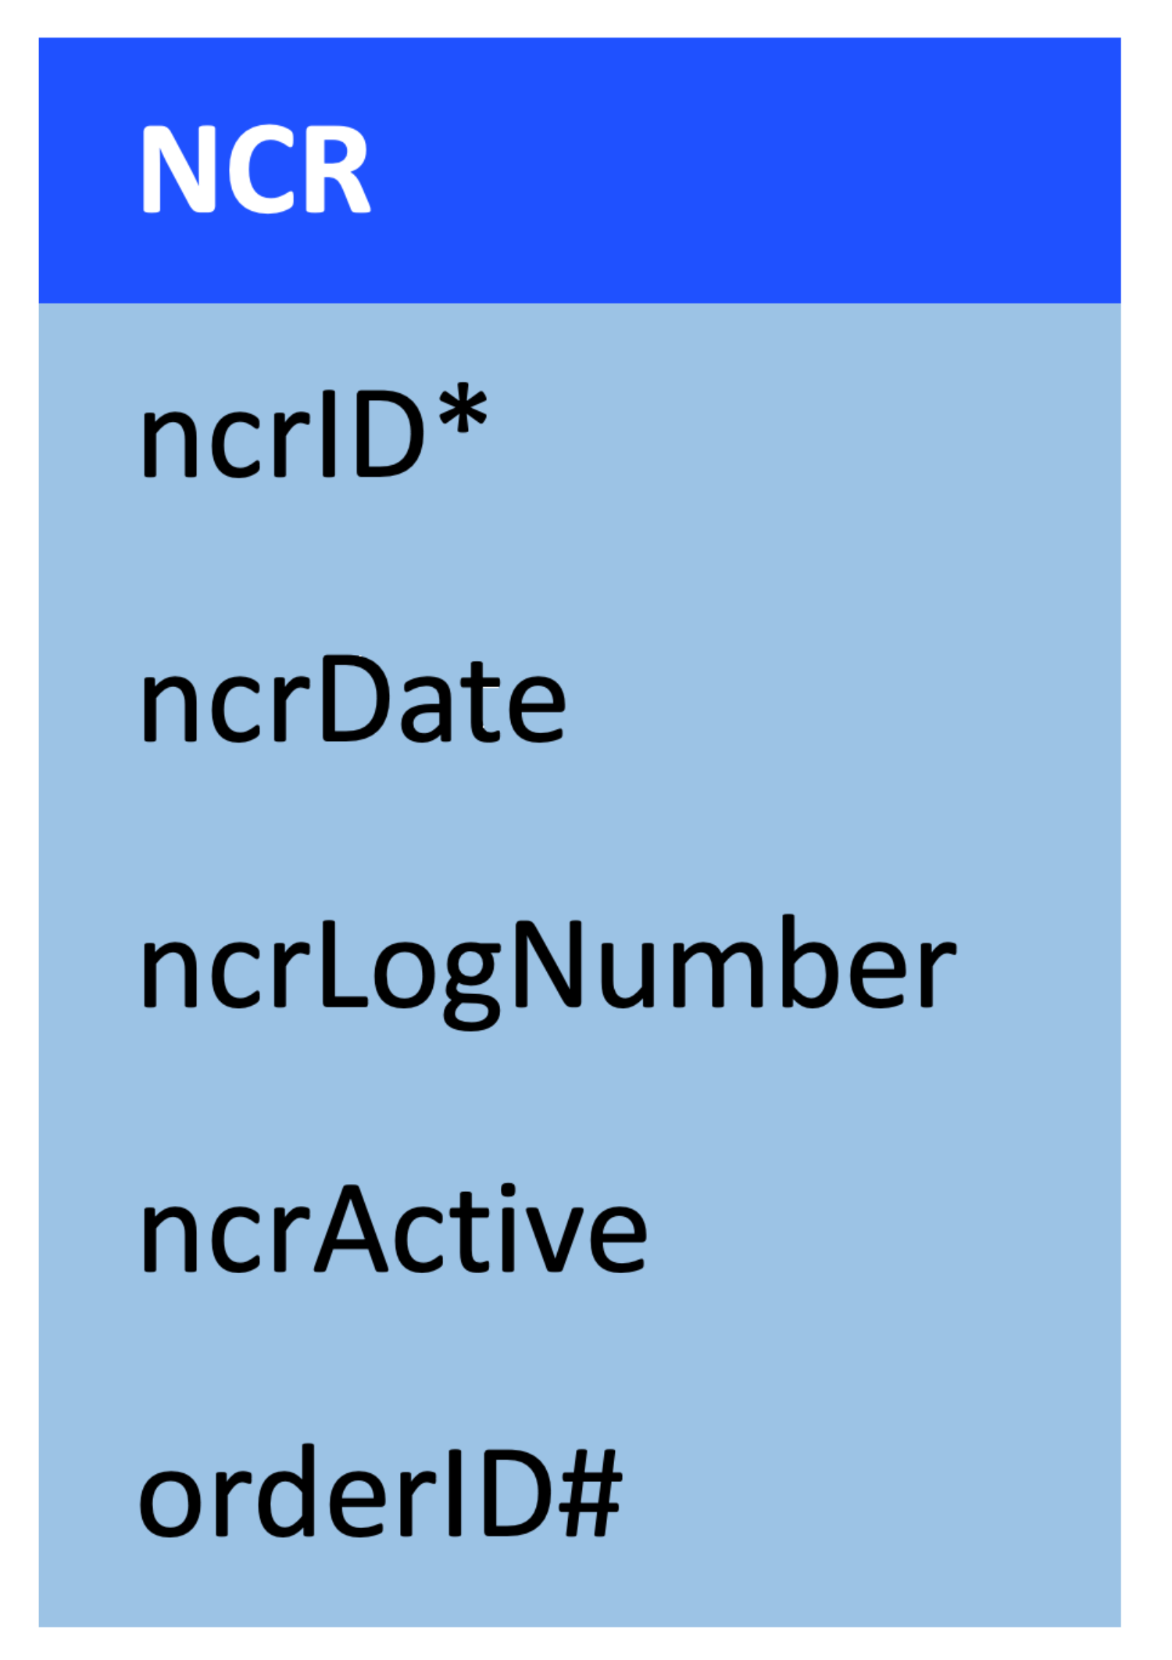
DATA MODEL v.1.0

Slide 14
REVISION
revID*
revNum
revDate
revUpdate
ncrID#
REVISIONLOG
revLogID*
revID#
>
Quality InsPector
SALE
saleID*
salesOrderReceiptNum
>
PRODUCT_ORDER
orderID*
orderProductNo
orderProductQuantity
prodID#
saleID#
PRODUCT
prodID*
prodNo
prodDescription
supplierID#
NCRQUALITYREP
qRepID*
ncrFormConfirm
ncrIdentityProcess
ncrDefectDescription
ncrQuantityDefective
ncrID#
>
>
SUPPLIER
supplierID*
supplierName
ncrLogNum#

Slide 15
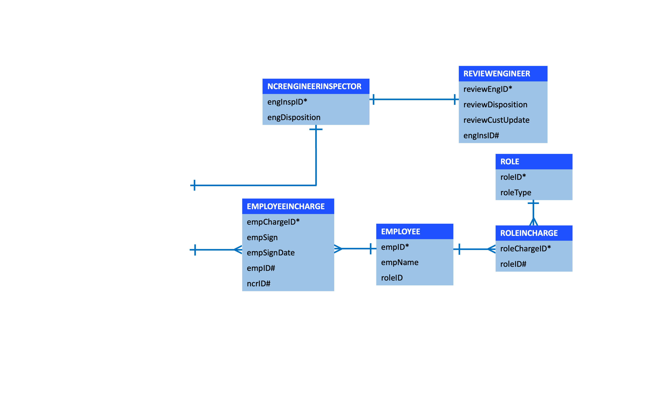
REVISION
revID*
revNum
revDate
revUpdate
ncrID#
REVISIONLOG
revLogID*
revID#
>
Quality InsPector
SALE
saleID*
salesOrderReceiptNum
>
PRODUCT_ORDER
orderID*
orderProductNo
orderProductQuantity
prodID#
saleID#
PRODUCT
prodID*
prodNo
prodDescription
supplierID#
NCRQUALITYREP
qRepID*
ncrFormConfirm
ncrIdentityProcess
ncrDefectDescription
ncrQuantityDefective
ncrID#
>
>
SUPPLIER
supplierID*
supplierName
ncrLogNum#
Engineering

Slide 16
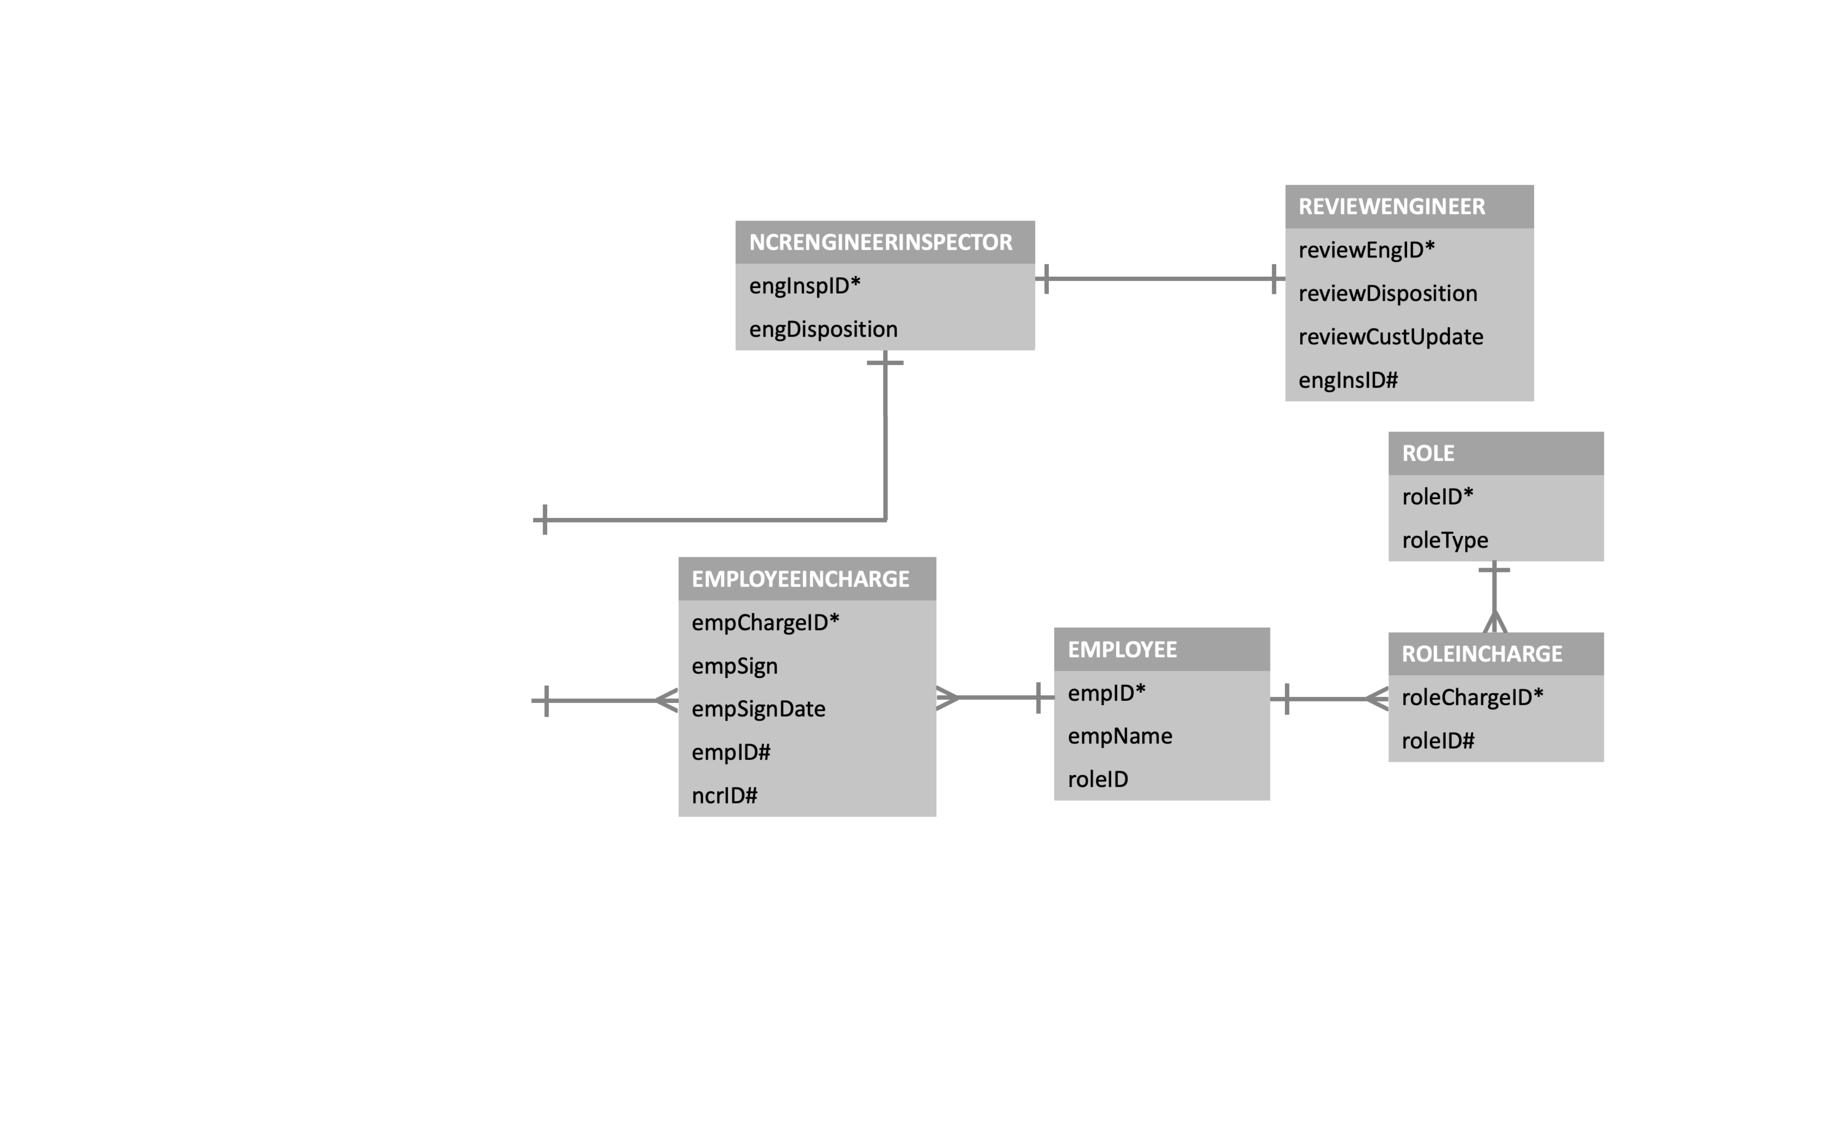
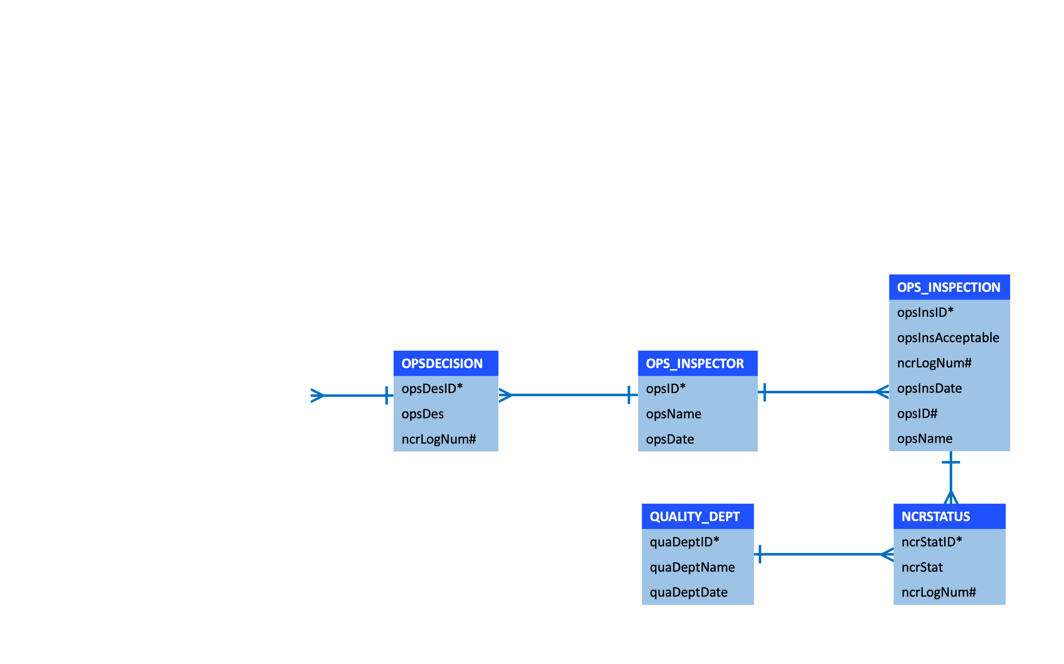
>
AUDIT
auditID*
CreatedBy
CreatedOn
Purchasing

Slide 17


ROLE
ALEX ARMANI
CROSSFIRE EMPLOYEE
QUALITY Rep
>
AUDIT
auditID*
CreatedBy
CreatedOn
Purchasing

Slide 18
ROLE
ALEX ARMANI
CROSSFIRE EMPLOYEE
QUALITY Rep

Slide 19
ROLE
ALEX ARMANI
CROSSFIRE EMPLOYEE
QUALITY Rep

Slide 20
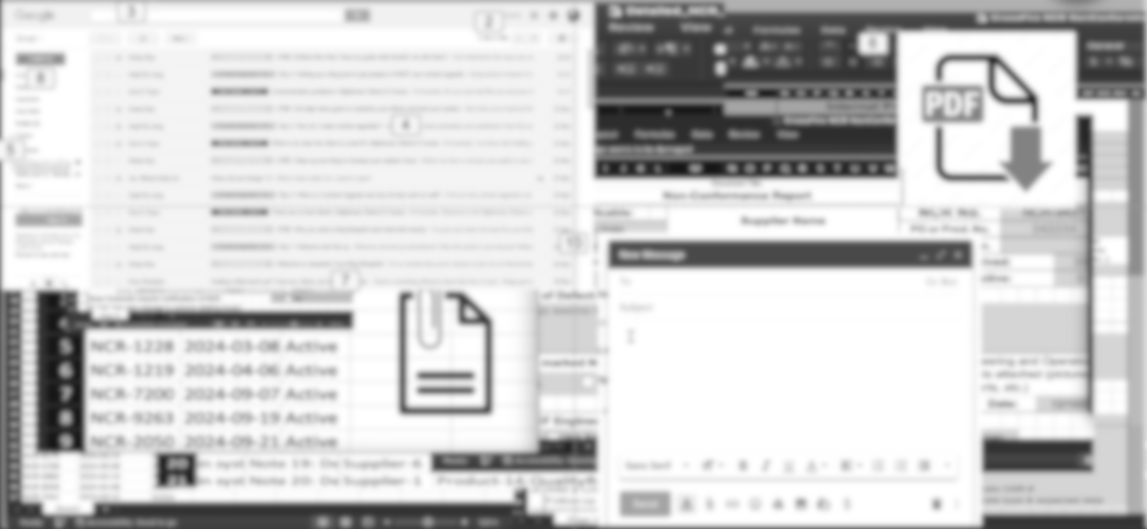
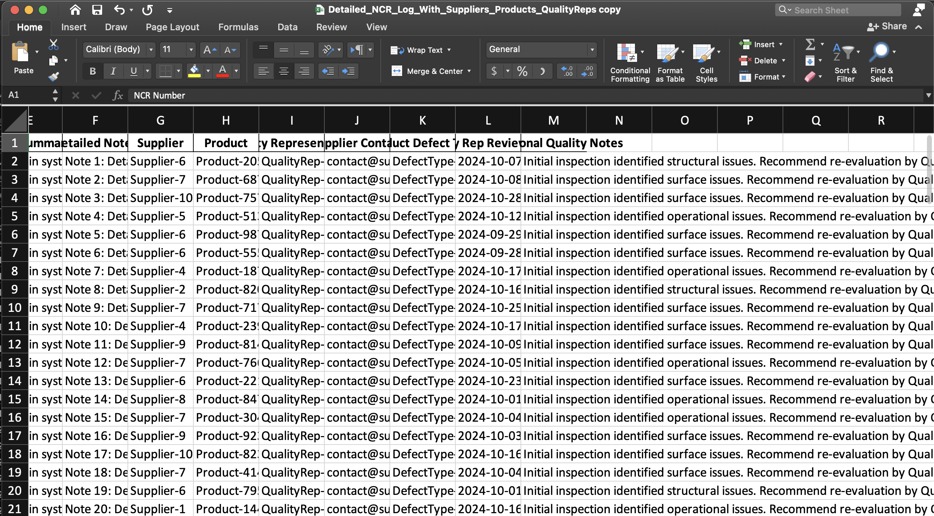
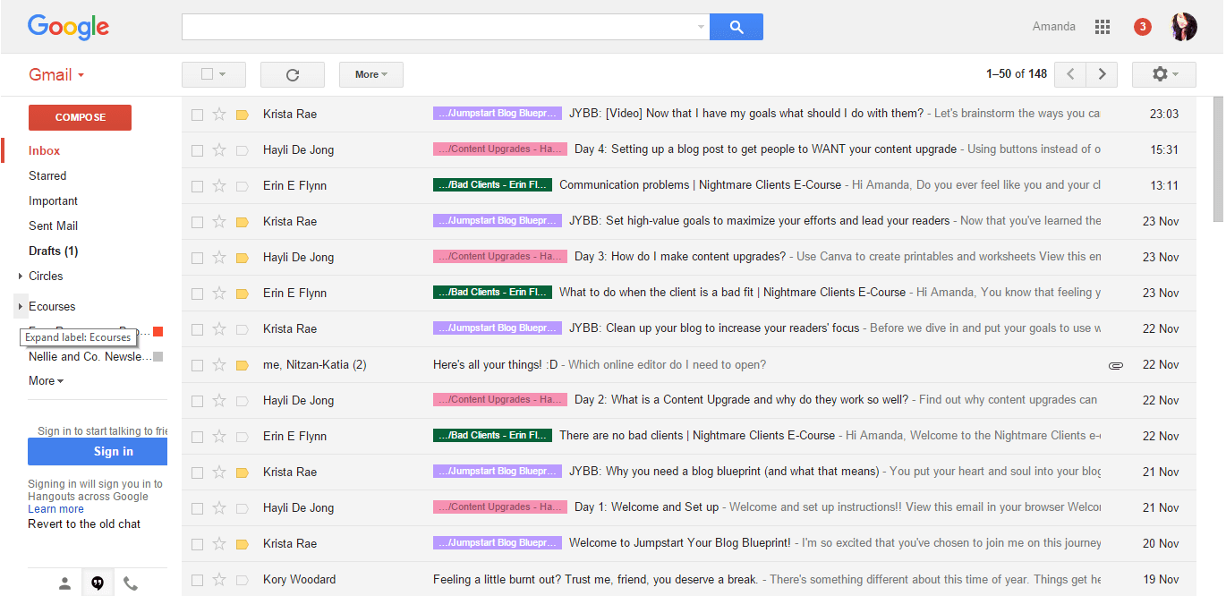
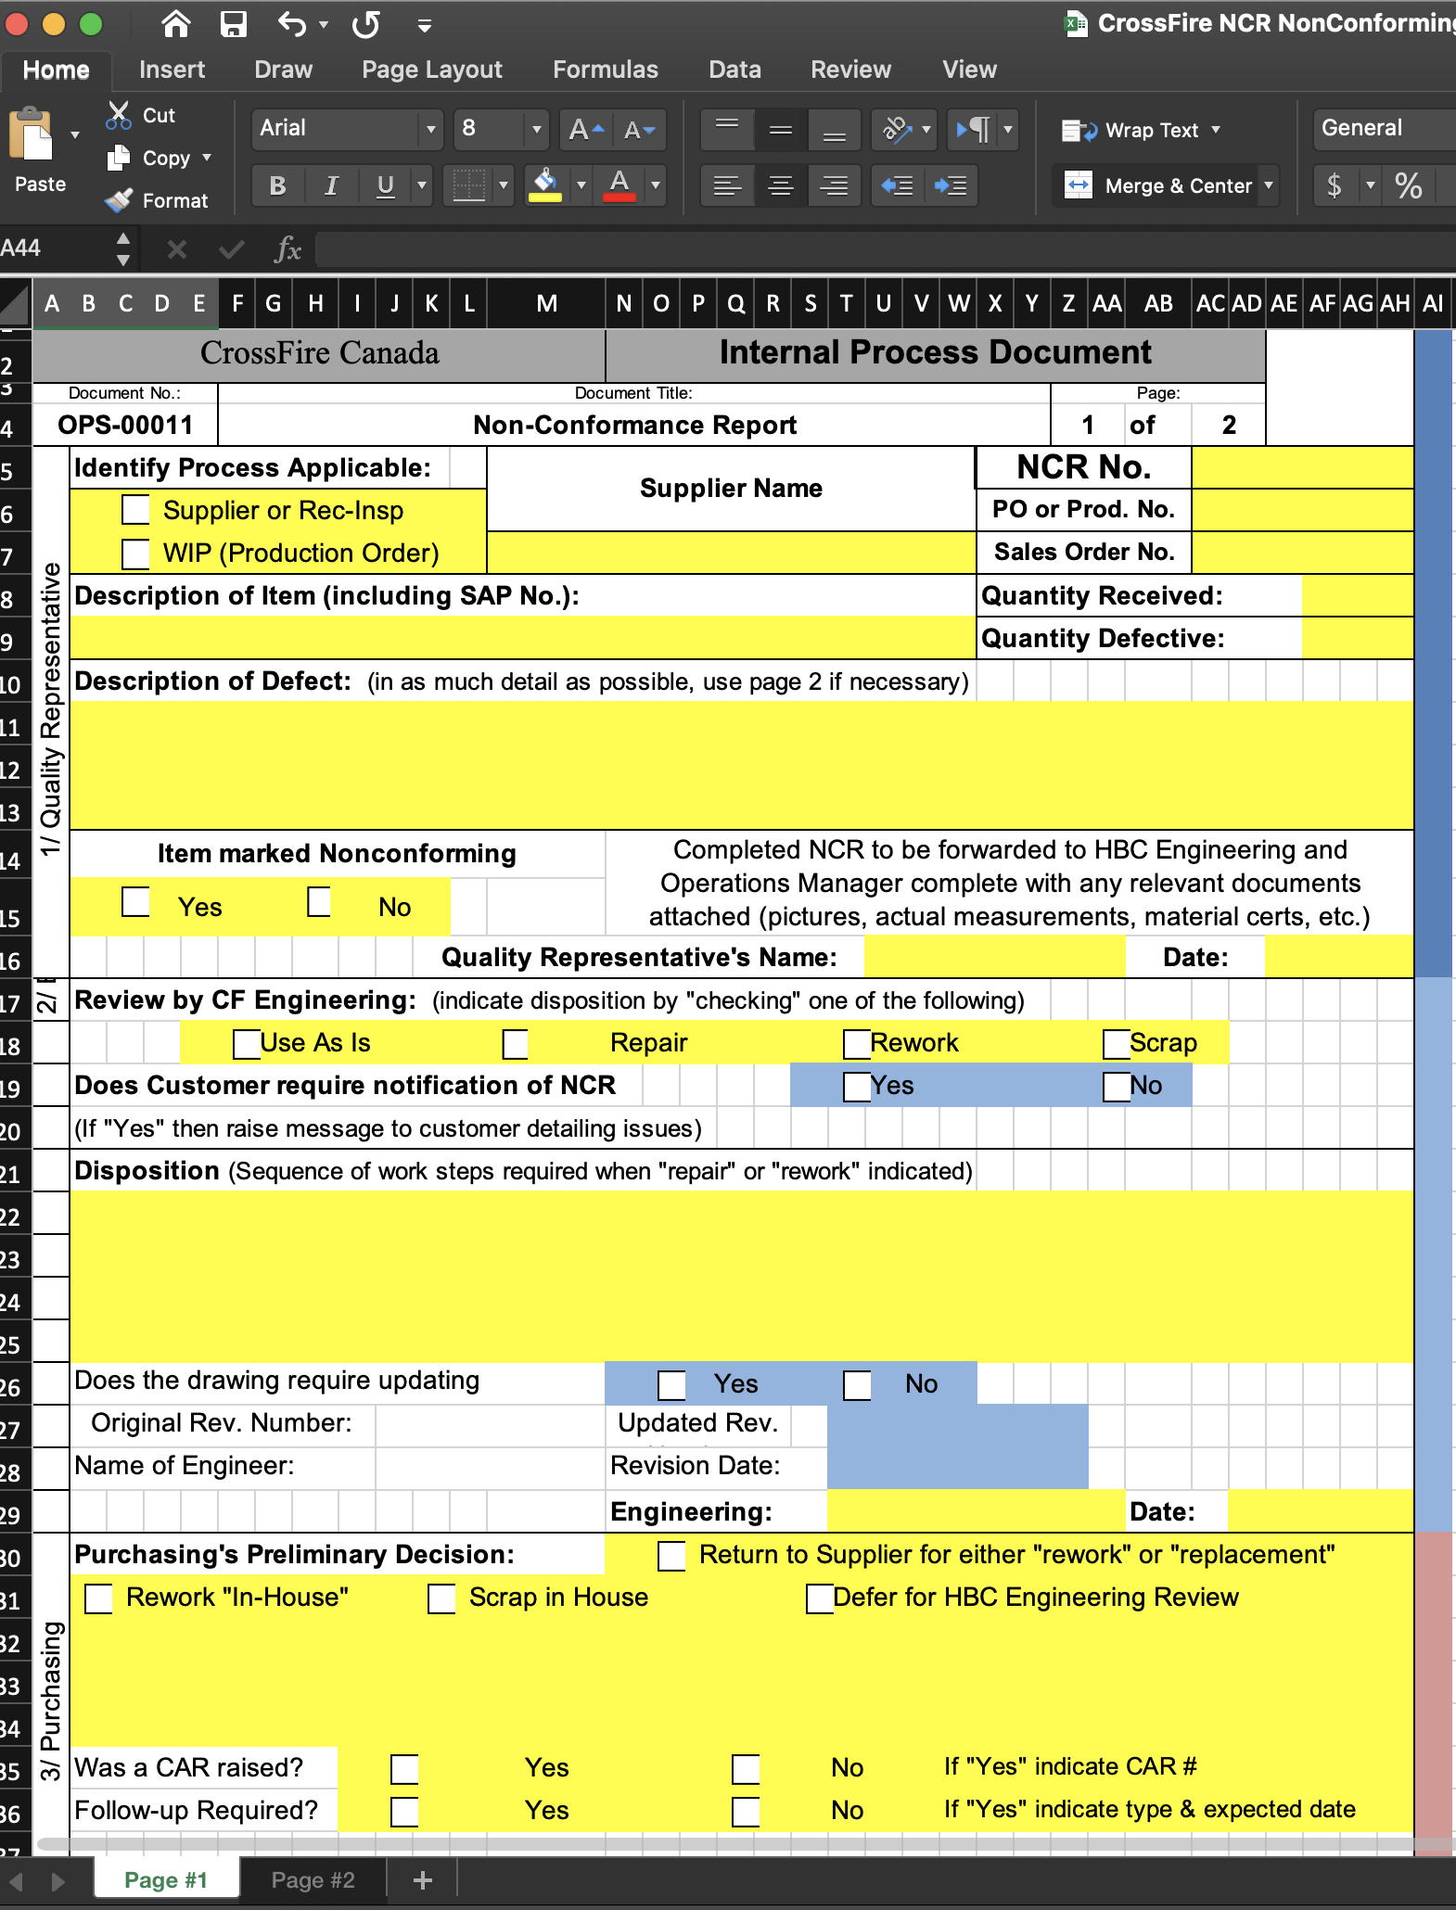
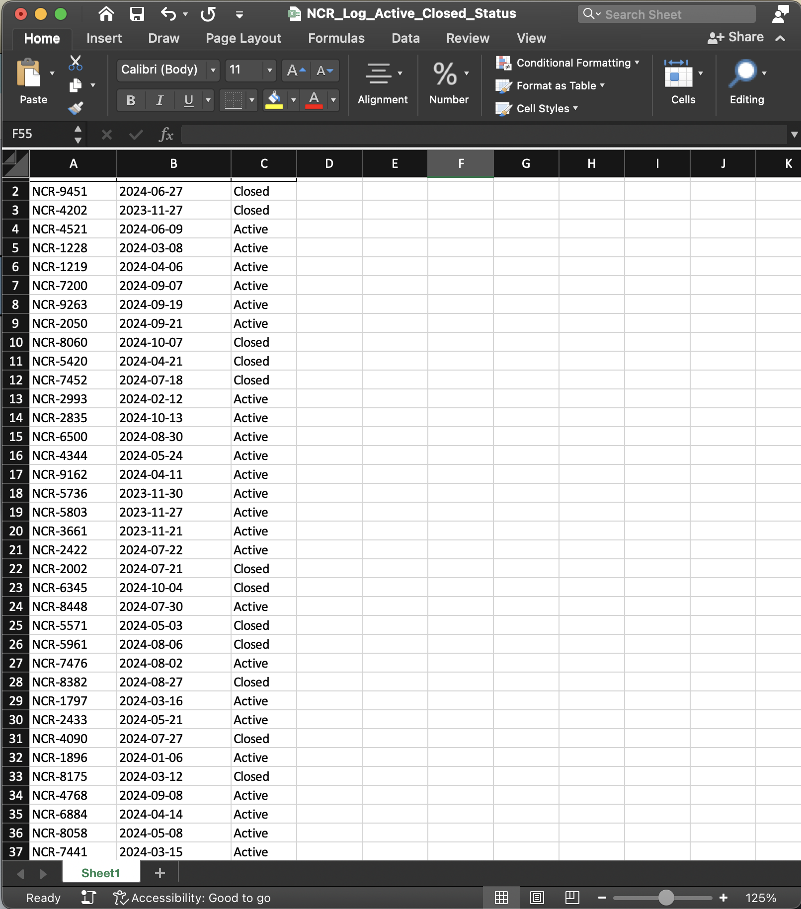

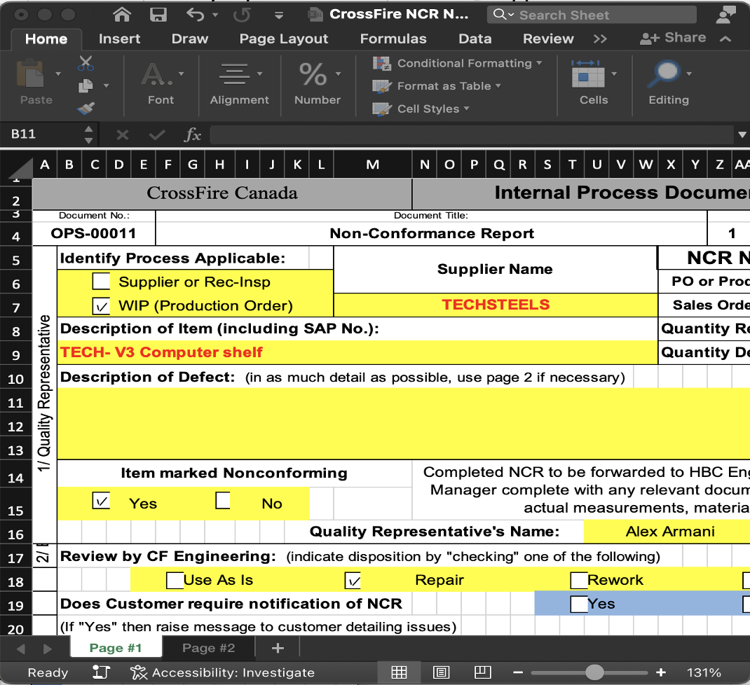

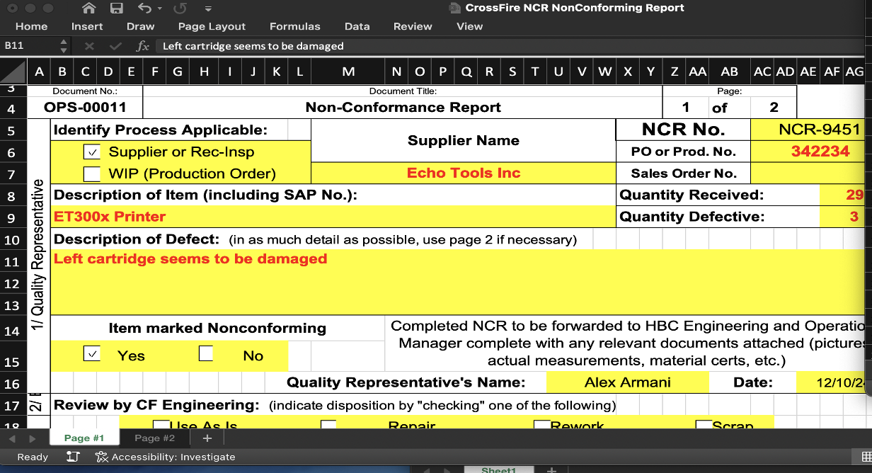
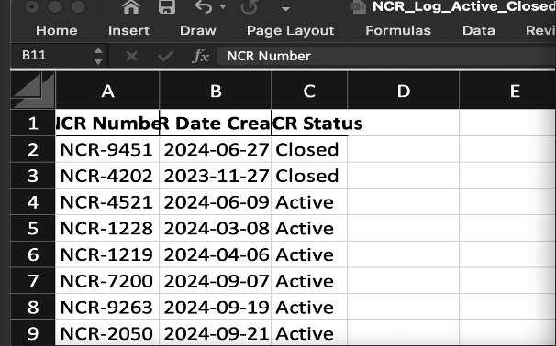
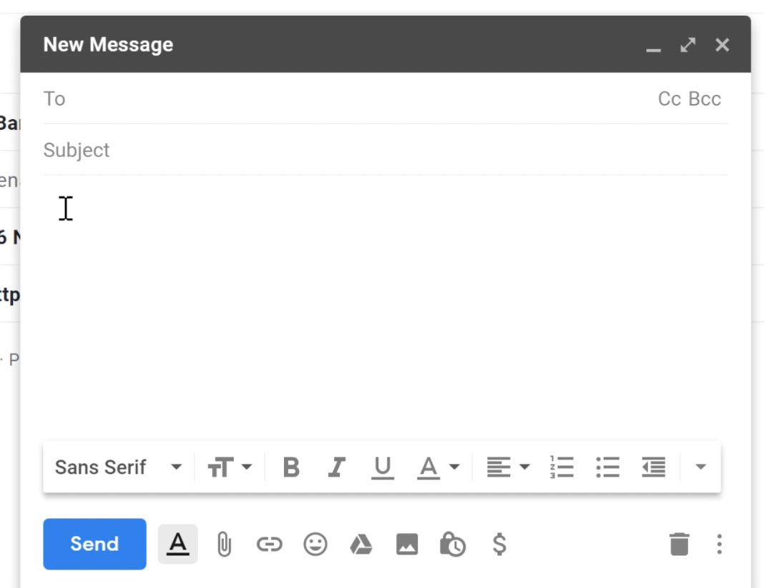


Current Process
Cluttered information
Hard to follow and No Ease of Access
Make the computer slower, taking more memory space
Too many separate processes (NCR, Sharing, etc.)
High time consumption
ROLE
ALEX ARMANI
CROSSFIRE EMPLOYEE
QUALITY Rep

Slide 21

Current Process
Cluttered information
Hard to follow and No Ease of Access
Make the computer slower, taking more memory space
Too many separate processes (NCR, Sharing, etc.)
High time consumption
ROLE

Slide 22
Current Process

Slide 23
THE OSS EFFECT
Less time consumption
and More efficiency
All in One record
generating and
keeping platform
Simplicity
and
Accessibility
Reducing reliance
on Excel

Slide 24
THE OSS EFFECT
Less time consumption
and More efficiency
All in One record
generating and
keeping platform
Simplicity
and
Accessibility
Reducing reliance
on Excel

Slide 25
THE OSS EFFECT
Less time consumption
and More efficiency
All in One record
generating and
keeping platform
Simplicity
and
Accessibility
Reducing reliance
on Excel

Slide 26
THE OSS EFFECT
Less time consumption
and More efficiency
All in One record
generating and
keeping platform
Simplicity
and
Accessibility
Reducing reliance
on Excel

Slide 27
Section 1 –
Quality Inspection
THE OSS EFFECT
Less time consumption
and More efficiency
All in One record
generating and
keeping platform
Simplicity
and
Accessibility
Reducing reliance
on Excel

Slide 28
Section 1 –
Quality Inspection
THE ’QUALITY REPRESENTATIVE’ SECTION
OF THE NCR FORM IS FILLED BY THE QUALITY
REP.
QUALITY REP. RECEIVES/STARTS
THE NCR FILE
THE NCR FILE IS SENT OVER TO THE
ENGINEERING DEPARTMENT FOR FURTHER
INSPECTION
THE RELEVANT ENGINEER RECEIVES
THE NOTIFICATION THAT A NEW NCR
REQUIRES THEIR ATTENTION

Slide 29
Section 1 –
Quality Inspection
THE ’QUALITY REPRESENTATIVE’ SECTION
OF THE NCR FORM IS FILLED BY THE QUALITY
REP.
QUALITY REP. RECEIVES/STARTS
THE NCR FILE
THE NCR FILE IS SENT OVER TO THE
ENGINEERING DEPARTMENT FOR FURTHER
INSPECTION
THE RELEVANT ENGINEER RECEIVES
THE NOTIFICATION THAT A NEW NCR
REQUIRES THEIR ATTENTION

Slide 30
Section 1 –
Quality Inspection
THE ’QUALITY REPRESENTATIVE’ SECTION
OF THE NCR FORM IS FILLED BY THE QUALITY
REP.
QUALITY REP. RECEIVES/STARTS
THE NCR FILE
THE NCR FILE IS SENT OVER TO THE
ENGINEERING DEPARTMENT FOR FURTHER
INSPECTION
THE RELEVANT ENGINEER RECEIVES
THE NOTIFICATION THAT A NEW NCR
REQUIRES THEIR ATTENTION

Slide 31
Section 1 –
Quality Inspection
THE ’QUALITY REPRESENTATIVE’ SECTION
OF THE NCR FORM IS FILLED BY THE QUALITY
REP.
QUALITY REP. RECEIVES/STARTS
THE NCR FILE
THE NCR FILE IS SENT OVER TO THE
ENGINEERING DEPARTMENT FOR FURTHER
INSPECTION
THE RELEVANT ENGINEER RECEIVES
THE NOTIFICATION THAT A NEW NCR
REQUIRES THEIR ATTENTION

Slide 32
Section 2 –
ENGINEERING
Section 1 –
Quality Inspection
THE ’QUALITY REPRESENTATIVE’ SECTION
OF THE NCR FORM IS FILLED BY THE QUALITY
REP.
QUALITY REP. RECEIVES/STARTS
THE NCR FILE
THE NCR FILE IS SENT OVER TO THE
ENGINEERING DEPARTMENT FOR FURTHER
INSPECTION
THE RELEVANT ENGINEER RECEIVES
THE NOTIFICATION THAT A NEW NCR
REQUIRES THEIR ATTENTION

Slide 33
Section 2 –
ENGINEERING
THE ENGINEER RECEIVES THE NCR
ON THEIR DASHBOARD. THE ENGINEER ALSO
HOLDS AUTHORITY TO START A NCR FILE
THE ENGINEER STUDIES THE NCR FILE
AND ADDS DATA RELEVANT TO THE
’ENGINEER’ SECTION OF THE NCR FORM
THE NCR FILE IS SENT OVER TO THE
PURCHASING DEPARTMENT FOR FURTHER
EVALUATION
THE RELEVANT PURCHASER RECEIVES
THE NOTIFICATION THAT A NEW NCR
REQUIRES THEIR ATTENTION

Slide 34
Section 2 –
ENGINEERING
THE ENGINEER RECEIVES THE NCR
ON THEIR DASHBOARD. THE ENGINEER ALSO
HOLDS AUTHORITY TO START A NCR FILE
THE ENGINEER STUDIES THE NCR FILE
AND ADDS DATA RELEVANT TO THE
’ENGINEER’ SECTION OF THE NCR FORM
THE NCR FILE IS SENT OVER TO THE
PURCHASING DEPARTMENT FOR FURTHER
EVALUATION
THE RELEVANT PURCHASER RECEIVES
THE NOTIFICATION THAT A NEW NCR
REQUIRES THEIR ATTENTION

Slide 35
Section 2 –
ENGINEERING
THE ENGINEER RECEIVES THE NCR
ON THEIR DASHBOARD. THE ENGINEER ALSO
HOLDS AUTHORITY TO START A NCR FILE
THE ENGINEER STUDIES THE NCR FILE
AND ADDS DATA RELEVANT TO THE
’ENGINEER’ SECTION OF THE NCR FORM
THE NCR FILE IS SENT OVER TO THE
PURCHASING DEPARTMENT FOR FURTHER
EVALUATION
THE RELEVANT PURCHASER RECEIVES
THE NOTIFICATION THAT A NEW NCR
REQUIRES THEIR ATTENTION

Slide 36
Section 2 –
ENGINEERING
THE ENGINEER RECEIVES THE NCR
ON THEIR DASHBOARD. THE ENGINEER ALSO
HOLDS AUTHORITY TO START A NCR FILE
THE ENGINEER STUDIES THE NCR FILE
AND ADDS DATA RELEVANT TO THE
’ENGINEER’ SECTION OF THE NCR FORM
THE NCR FILE IS SENT OVER TO THE
PURCHASING DEPARTMENT FOR FURTHER
EVALUATION
THE RELEVANT PURCHASER RECEIVES
THE NOTIFICATION THAT A NEW NCR
REQUIRES THEIR ATTENTION

Slide 37
Section 3 –
PURCHASING
Section 2 –
ENGINEERING
THE ENGINEER RECEIVES THE NCR
ON THEIR DASHBOARD. THE ENGINEER ALSO
HOLDS AUTHORITY TO START A NCR FILE
THE ENGINEER STUDIES THE NCR FILE
AND ADDS DATA RELEVANT TO THE
’ENGINEER’ SECTION OF THE NCR FORM
THE NCR FILE IS SENT OVER TO THE
PURCHASING DEPARTMENT FOR FURTHER
EVALUATION
THE RELEVANT PURCHASER RECEIVES
THE NOTIFICATION THAT A NEW NCR
REQUIRES THEIR ATTENTION

Slide 38
Section 3 –
PURCHASING
THE PURCHASER RECEIVES THE NOTIFICATION
OF NCR ON THEIR DASHBOARD. THEY
CAN ALSO START A NCR FILE, IF NECESSARY
THE PURCHASER LOOKS INTO THE NCR
FILE AND EVALUATES THE SITUATION
THE PURCHASER ADDS DATA RELEVANT
TO THE ’ENGINEER’ SECTION OF THE NCR FORM
AFTER EVALUATION
THE NCR IS EITHER ‘CLOSED’ OR SENT
OVER TO THE QUALITY INSPECTION
DEPARTMENT AGAIN FOR
FURTHER INSPECTION

Slide 39
Section 3 –
PURCHASING
THE PURCHASER RECEIVES THE NOTIFICATION
OF NCR ON THEIR DASHBOARD. THEY
CAN ALSO START A NCR FILE, IF NECESSARY
THE PURCHASER LOOKS INTO THE NCR
FILE AND EVALUATES THE SITUATION
THE PURCHASER ADDS DATA RELEVANT
TO THE ’ENGINEER’ SECTION OF THE NCR FORM
AFTER EVALUATION
THE NCR IS EITHER ‘CLOSED’ OR SENT
OVER TO THE QUALITY INSPECTION
DEPARTMENT AGAIN FOR
FURTHER INSPECTION

Slide 40
Section 3 –
PURCHASING
THE PURCHASER RECEIVES THE NOTIFICATION
OF NCR ON THEIR DASHBOARD. THEY
CAN ALSO START A NCR FILE, IF NECESSARY
THE PURCHASER LOOKS INTO THE NCR
FILE AND EVALUATES THE SITUATION
THE PURCHASER ADDS DATA RELEVANT
TO THE ’ENGINEER’ SECTION OF THE NCR FORM
AFTER EVALUATION
THE NCR IS EITHER ‘CLOSED’ OR SENT
OVER TO THE QUALITY INSPECTION
DEPARTMENT AGAIN FOR
FURTHER INSPECTION

Slide 41
Section 3 –
PURCHASING
THE PURCHASER RECEIVES THE NOTIFICATION
OF NCR ON THEIR DASHBOARD. THEY
CAN ALSO START A NCR FILE, IF NECESSARY
THE PURCHASER LOOKS INTO THE NCR
FILE AND EVALUATES THE SITUATION
THE PURCHASER ADDS DATA RELEVANT
TO THE ’ENGINEER’ SECTION OF THE NCR FORM
AFTER EVALUATION
THE NCR IS EITHER ‘CLOSED’ OR SENT
OVER TO THE QUALITY INSPECTION
DEPARTMENT AGAIN FOR
FURTHER INSPECTION

Slide 42
Section 3 –
PURCHASING
THE PURCHASER RECEIVES THE NOTIFICATION
OF NCR ON THEIR DASHBOARD. THEY
CAN ALSO START A NCR FILE, IF NECESSARY
THE PURCHASER LOOKS INTO THE NCR
FILE AND EVALUATES THE SITUATION
THE PURCHASER ADDS DATA RELEVANT
TO THE ‘PURCHASING’ SECTION OF THE
NCR FORM AFTER EVALUATION
THE NCR IS EITHER ‘CLOSED’ OR SENT
OVER TO THE QUALITY INSPECTION
DEPARTMENT AGAIN FOR
FURTHER INSPECTION

Slide 43
PLANs moving forward
In the event of Crossfire’s agreement to this project:
A new meeting will be set up with the client to discuss the project’s requirements in detail.
The meeting will be 1 week from now.
A Client Contract will be drafted and both parties have it signed in the next meeting.
A 40% deposit will be received from the client to officially commence work on the project.

Slide 44
OPTIMAL SOFTWARE SOLUTIONS
Thank you for your time

